Slide 1
2023-04-19

Slide 2
Upcoming Schedule
Monday | Wednesday | Friday
04/17/2023 (90) • Review: Unit 5, Unit 9 • AP CS Question 2: Classes | 04/19/2023 (90) • Review: Units 6-7 • AP CS Question 3: Array/ArrayList | 04/21/2023 (45) • Review: Unit 10 • More recursion exercises like we did on Apr-7
04/24/2023 (90) • Review: Unit 8 • AP CS Question 4: 2D Array | 04/26/2023 (90) • AP CS Multiple Choice Game | 04/28/2023 (45) • Review: Unit 7, Unit 10 • Algorithms: Iterative/recursive binary search, selection sort, insertion sort, merge sort
05/01/2023 • FINAL | 05/03/2023 • AP EXAM

Slide 3
Units 6-7
AP CS FRQ 3 (Array and ArrayList)

Slide 4
6.1: Creating and Using Arrays

Slide 5
Arrays - Declaration
An Array variable is is a collection of values of the same type and can be declared like this
type[] name;
boolean[] answers; String[] questions; int[] scores; Student[] students;
Note: type name[] is also valid syntax for creating an array.
Note: Arrays in Java are Object types. As-written - these Array variables are initialized to null and your code will fail if you attempt to access them.
So...

Slide 6
Arrays - Creation
Note 1: Each of these Array variables now have a value assigned to them - And can be referenced by your code.
Note 2: After creation every Array has an available length property (which never changes)
Arrays are created with an initializer list or new
boolean[] answers = {true, false, false, true}; int[] scores = {100, 84, 95, 78}; double[] prices = new double[20]; String[] questions = new String[5]; int numStudents = 10; Student[] students = new Student[numStudents];

Slide 7
Arrays - Creation
boolean[] answers = {true, false, false, true};
int[] scores = {100, 84, 95, 78};
booleans
answers
true
false
false
true
0
1
2
3
answers.length: 4
ints
scores
100
84
95
78
0
1
2
3
scores.length: 4

Slide 8
Arrays - Creation - Primitive Defaults
boolean[] answers = new boolean[4];
int[] scores = new int[4];
booleans
answers
false
false
false
false
0
1
2
3
answers.length: 4
ints
scores
0
0
0
0
0
1
2
3
scores.length: 4

Slide 9
Arrays - Creation
Using new to re-assign an Array is allowed
boolean[] answers = {true, false, false, true};
This works!
answers = new boolean[4];
This also works...
answers = new boolean[] { true, false, false, true };

Slide 10
Arrays - Access - length
The length of an Array can be determined via the length property. Note: The length of a String is accessed via the String.length() method.
boolean[] answers = {true, false, false, true}; System.out.println(answers.length); A> 4 String[] questions = new String[5]; System.out.println(questions.length); B> 5

Slide 11
Arrays - Access - READING
Items in an Array can be read using the [] operator, e.g. array[index] Note: Like String - index is zero-based and the range of valid index values is 0 to length-1
boolean[] answers = {true, false, false, true}; System.out.print(answers[2] + ", " + answers[0]); C> false, true int[] scores = {100, 84, 95, 78}; System.out.print(scores[1] + ", " + scores[3]); D> 84, 78
Note: Passing an out of range index will cause a ArrayIndexOutOfBoundsException!

Slide 12
Arrays - Access - WRITING
Items in an Array can be assigned with via the [] operator. Note: Unlike String - you can change the values in an Array after it is created (however you cannot change its length after creation)
boolean[] answers = {true, false, false, true}; answers[2] = true; answers[0] = false; System.out.print(answers[2] + ", " + answers[0]); C> true, false int[] scores = {100, 84, 95, 78}; scores[1] = 48; scores[3] = 87; System.out.print(scores[1] + ", " + scores[3]); D> 84, 87

Slide 13
Arrays - Access - Object Types
Arrays that hold Object types work a little differently than those that hold primitive types
We already saw that the length properly works String[] questions = new String[5]; System.out.println(questions.length); B> 5
But what about reading and writing values in an Array that holds Object types? System.out.println(questions[1]); E> ?

Slide 14
Arrays - Access - Object Types
Arrays that hold Object types work a little differently than those that hold primitive types
We already saw that the length properly works String[] questions = new String[5]; System.out.println(questions.length); B> 5
But what about reading and writing values in an Array that hold Object types?

Slide 15
Arrays - Access - Object Types
But what about reading and writing values in an Array that holds Object types? String[] questions = new String[5]; System.out.println(questions[1]); E> null
Student[] students = new Student[10]; System.out.println(students[1]); F> null
For Arrays that hold Object types - each slot will be be initialized to null
Initialize each Array slot with new
students[0] = new Student();
students[1] = new Student();
students[2] = new Student();
...

Slide 16
Arrays - Creation
String[] questions = new String[5];
Student[] students = new Student[10];
Strings
questions
null
null
null
null
null
0
1
2
3
4
questions.length: 5
Students
students
null
null
null
null
null
null
null
null
null
null
0
1
2
3
4
5
6
7
8
9
students.length: 10

Slide 17
Arrays - Creation
String[] questions = new String[5];
Student[] students = new Student[10];
Strings
questions
null
null
null
null
null
0
1
2
3
4
questions.length: 5
Students
students
null
null
null
null
null
null
null
null
null
0
1
2
3
4
5
6
7
8
9
students.length: 10
students[0] = new Student();
Student

Slide 18
6.2: Traversing Arrays with
for loops

Slide 19
Traversing Arrays with for loops
Evaluate initialization expression
Now we can now combine this with what we have learned about accessing Arrays
Arrays have a property called length and elements can be access via [] and an index
Does condition evaluate to true?
Yes
for (initialization; condition; increment)
statement
No
Execute body statement
Example:
int[] scores = {95, 100, 91, 85 };
for (int idx = 0; idx < scores.length; idx++) {
System.out.println(scores[idx]);
}
Evaluate increment expression
Next statement after for

Slide 20

Traversing Arrays with for loops
Remember that the range of valid Array indexes (for non-empty Arrays) is 0 to array.length - 1
int[] scores = {95, 100, 91, 85 };
for (int idx = 0; idx < scores.length; idx++) {
System.out.println(scores[idx]);
}
This loop also skips the first element in the Array!
int[] scores = {95, 100, 91, 85 };
for (int idx = 1; idx <= scores.length; idx++) {
System.out.println(scores[idx]);
}
Note: Passing an out of range index will cause a ArrayIndexOutOfBoundsException!

Slide 21
Traversing Arrays with for loops
You can use a for loop to traverse an Array from back to front!
int[] scores = {95, 100, 91, 85 };
for (int idx = scores.length - 1; idx >= 0; idx--) {
System.out.println(scores[idx]);
}

Slide 22
Traversing Arrays with for loops
You can use a for loop to traverse an Array from back to front!
int[] scores = {95, 100, 91, 85 };
for (int idx = scores.length - 1; idx >= 0; idx--) {
System.out.println(scores[idx]);
}
...or to traverse any arbitrary range of elements
int[] scores = {95, 100, 91, 85 };
for (int idx = 1; idx <= 2; idx++) {
System.out.println(scores[idx]);
}

Slide 23
6.3: Traversing Arrays with
for-each loops

Slide 24
Traversing Arrays with for-each loops
An alternate way to loop through objects that support the Iterable interface
for (type arrayItemVariable : arrayVariable) { arrayItemVariable is a copy of arrayVariable[0] arrayItemVariable is a copy of arrayVariable[1] arrayItemVariable is a copy of arrayVariable[...] arrayItemVariable is a copy of arrayVariable[arrayVariable.length-1] then the loop terminates }

Slide 25
Traversing Arrays with for-each loops
for (type arrayItemVariable : arrayVariable) { arrayItemVariable resolves to arrayVariable[...] }
String[] colors = {"red", "orange", "purple"}; System.out.println("begin"); for(String color: colors){ System.out.println(" " + color); } System.out.println("end");
Output:
begin
red
orange
purple end

Slide 26

Traversing Arrays with for-each loops
The type of the for-each variable MUST match the type of the values stored in the Array
String[] colors = {"red", "orange", "purple"}; for(int color : colors){ System.out.println(" " + color); }
Note: color must be of type String since colors is an Array that contains Strings

Slide 27
Comparing for and for-each loops
for
Direct access to any element in the Array - in any order - using zero-based index and []
You always know the index - so using parallel Arrays is easy!
May require more variables to efficiently operate
Can change the value of an Array element during the loop
for-each
Sequential access to the elements in the Array - must always go from first to last
You do not know the index - so using Parallel Arrays is harder (impossible?)
May eliminate the need for extra variables (no need to use indexes to access an item)
Cannot change the value of an Array element during the loop

Slide 28
7.1: ArrayList

Slide 29
ArrayList
ArrayLists are collections of values of the same Object type; But have different declaration syntax than Arrays; Primitive types (int, boolean, double, etc.) are not supported
ArrayList<type> name;
Examples
ArrayList<boolean> answers; ** PRIMITIVE TYPES UNSUPPORTED ** ArrayList<Boolean> answers; ArrayList<int> scores; ** PRIMITIVE TYPES UNSUPPORTED ** ArrayList<Integer> scores; ArrayList<String> questions; ArrayList<Student> students;
Important: You must import ArrayList prior to using it import java.util.ArrayList;

Slide 30
Generics / Generic Types
ArrayList is an example of a class that uses a Generic Type
ArrayList<type> name;
Generic Types are an option when the same code can be used across a variety of data types – and frees you from needing to create an overloaded method for every type
ArrayList is able to use Generic Types because the internals assume everything is a Object type (and all Object types share the functionality required for ArrayList to work)
You can read more about Generics in the online Java documentation
Oracle Java Documentation: Why Use Generics?

Slide 31
ArrayList
Like Arrays, you must initialize ArrayLists prior to using them; The most common usage is with the no-parameter Constructor ArrayList<Boolean> answers = new ArrayList<Boolean>(); ArrayList<Integer> scores = new ArrayList<Integer>(); ArrayList<String> questions = new ArrayList<String>(); ArrayList<Student> students = new ArrayList<Student>();
Note: There are two other ArrayList Constructors that you can explore on your own ArrayList<type> name = new ArrayList<type>(Collection<type> c); ArrayList<type> name = new ArrayList<type>(init initialCapacity);

Slide 32
ArrayList
Unlike Arrays, ArrayLists automatically manage their memory usage as you ArrayList.add() and ArrayList.remove() elements to/from the the ArrayList
Unlike Arrays, ArrayLists do not have a length property that indicates the fixed-size of the Array; They have the ArrayList.size() method that indicates the current number of elements included in the ArrayList
ArrayLists have an internal capacity - which you cannot access - that grows and shrinks as needed to ensure elements can be quickly added. The default capacity is 10.
The capacity is adjusted to ensure that the there is enough free space to quickly accommodate new items via ArrayList.add(); But not so much excess free space that available memory is wasted

Slide 33
Array vs ArrayList
Array
true
false
true
false
false
false
false
false
false
false
0
1
2
3
4
5
6
7
8
9
boolean[] answers = new boolean[10]; answers[0] = true; answers[1] = false; answers[2] = true; answers.length == 10 answers[3-9] are set to default values
ArrayList
true
false
true
0
1
2
3
4
5
6
7
8
9
ArrayList<Boolean> answers = new ArrayList<Boolean>(); answers.add(true); answers.add(false); answers.add(true); answers.size() == 3 answers[3-9] are unused pre-allocated capacity

Slide 34
ArrayList Methods

Slide 35
ArrayList Methods
Signatures
boolean add(E obj)
void add(int index, E obj)
Overview
Add an item either to the end of the ArrayList (always returns true) or at the specified index (existing items will shift right; their index values will increase by 1)
The first version of add() always returns true because ArrayList implements the Collection interface - which can be implemented by other classes to restrict the creation of duplicate or null elements (ArrayList has no such restrictions)
Automatically increases the ArrayList capacity as needed
Will throw IndexOutOfBoundsException if index is out of range (index < 0 || index > size())
add()
clear()
get()
isEmpty()
remove()
removeRange()
set()
size()
ArrayList index values are zero-based (just like Arrays)

Slide 36
ArrayList Methods
add()
clear()
get()
isEmpty()
remove()
removeRange()
set()
size()
Signatures
void clear()
Overview
Removes all elements from the ArrayList
After this call ArrayList.size() == 0
Automatically decreases the ArrayList capacity as needed

Slide 37
ArrayList Methods
add()
clear()
get()
isEmpty()
remove()
removeRange()
set()
size()
Signatures
E get(int index)
Overview
Returns the element at the specified position in the ArrayList
You must use this method to access the items in an ArrayList; ArrayList does not support the [] syntax of Arrays
Will throw IndexOutOfBoundsException if index is out of range (index < 0 || index >= size())
ArrayList index values are zero-based (just like Arrays)

Slide 38
ArrayList Methods
add()
clear()
get()
isEmpty()
remove()
removeRange()
set()
size()
Signatures
boolean isEmpty()
Overview
Returns true if the ArrayList has no items

Slide 39
ArrayList Methods
It really is Object, not E, here.
Historical reasons.
Signatures
boolean remove(Object obj)
E remove(int index)
Overview
Removes the first item from the ArrayList that matches obj; or at the specified index (existing items will shift left; their index values will decrease by 1)
remove(Object obj) returns true/false if an element in the ArrayList returns true for obj.equals(element) (or obj == null == element) and was removed
Note: Does not use Object equality (obj == element)
remove(int index) returns the element that was removed from the ArrayList
Automatically decreases the ArrayList capacity as needed
Will throw IndexOutOfBoundsException if index is out of range (index < 0 || index >= size())
add()
clear()
get()
isEmpty()
remove()
removeRange()
set()
size()
ArrayList index values are zero-based (just like Arrays)

Slide 40
ArrayList Methods
add()
clear()
get()
isEmpty()
remove()
removeRange()
set()
size()
Signatures
void removeRange(int fromIndex, int toIndex)
Overview
Removes all of the elements whose index is between fromIndex (inclusive) and toIndex (exclusive). Shifts any succeeding elements to the left (reduces their index).
Automatically decreases the ArrayList capacity as needed
Will throw IndexOutOfBoundsException if fromIndex or toIndex is out of range (fromIndex < 0 || fromIndex >= size() || toIndex > size() || toIndex < fromIndex)
ArrayList index values are zero-based (just like Arrays)

Slide 41
ArrayList Methods
add()
clear()
get()
isEmpty()
remove()
removeRange()
set()
size()
Signatures
E set(int index, E element)
Overview
Replaces the element at the specified position in this ArrayList with the specified element.
Returns the element that was removed from the ArrayList at index
You must use this method to access the items in an ArrayList; ArrayList does not support the [] syntax of Arrays
Will throw IndexOutOfBoundsException if index is out of range (index < 0 || index >= size())
ArrayList index values are zero-based (just like Arrays)

Slide 42
ArrayList Methods
add()
clear()
get()
isEmpty()
remove()
removeRange()
set()
size()
Signatures
int size()
Overview
Returns the number of elements in this ArrayList

Slide 43
7.3: Traversing ArrayLists with Loops

Slide 44
Traversing ArrayLists
ArrayLists support the same mechanisms you used when traversing Arrays - while, for, for-each - with the following differences
Operation | Array | ArrayList
length/size | Array.length (property) | ArrayList.size() (method)
read | value = array[index]; | value = arrayList.get(index);
write | array[index] = value; | arrayList.set(index, value);

Slide 45
Traversing ArrayLists
Array - for loop
Integer[] array = {1, 2, 3, 4, 5}; for (int idx = 0 ; idx < array.length ; idx++) { int value = array[idx]; System.out.println(value); array[idx] = value + 1; }
ArrayList - for loop
Integer[] array = {1, 2, 3, 4, 5}; ArrayList<Integer> arrayList = new ArrayList<Integer>(Arrays.asList(array)); for (int idx = 0 ; idx < arrayList.size() ; idx++) { int value = arrayList.get(idx); System.out.println(value); arrayList.set(idx, value + 1); }

Slide 46
Traversing ArrayLists
Array & ArrayList - for loop ArrayIndexOutOfBoundsException
This exception will be thrown if you try to access the item at an index less than 0 or greater than the number of items in the Array or ArrayList

Slide 47
Traversing ArrayLists
Array - for-each loop
Integer[] array = {1, 2, 3, 4, 5}; for (Integer value : array) { System.out.println(value); }
ArrayList - for-each loop
Integer[] array = {1, 2, 3, 4, 5}; ArrayList<Integer> arrayList = new ArrayList<Integer>(Arrays.asList(array)); for (Integer value : arrayList) { System.out.println(value); }

Slide 48
Traversing ArrayLists
ArrayList for-each loop ConcurrentModificationException
This exception will be thrown if you try to add or remove items from an ArrayList while traversing that ArrayList with a for-each loop

Slide 49
6.4: Array Algorithms

Slide 50
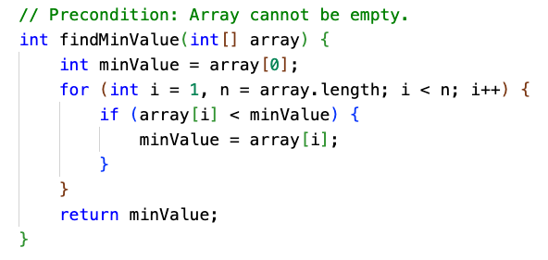
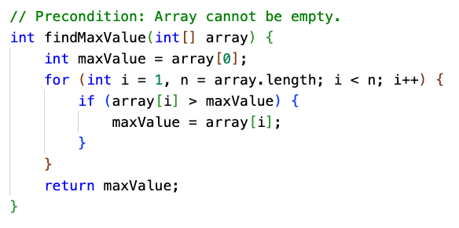
Minimum and Maximum Value
These require a "tracking value" for the smallest or largest value found so far.
25 | 70 | 9 | 3 | 15 | 16 | 19
minV =
25
25
9
3
3
3
3
One trick is to "seed" the tracking value with the first element, and skip it in the loop.

Slide 51
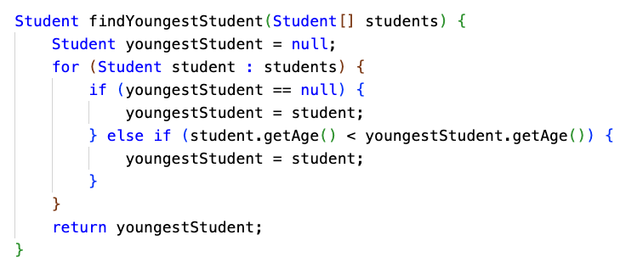
Minimum and Maximum Value of Objects
You might be dealing with an array of something other than numbers, and the array might possibly be empty.
// Precondition: No element in students will be null, but students.length may be 0
Instead of seeding the tracking value, we used null to mean no value yet

Slide 52
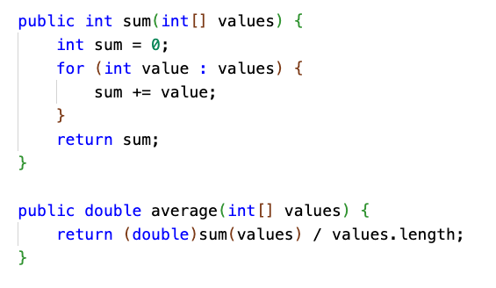
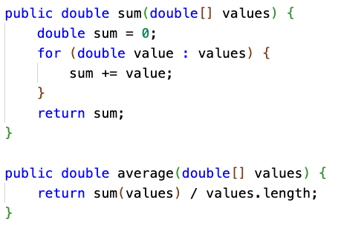
Sum and Average
If dealing with int, remember to promote/cast to double when calculating average. (Also known as the arithmetic mean.)

Slide 53
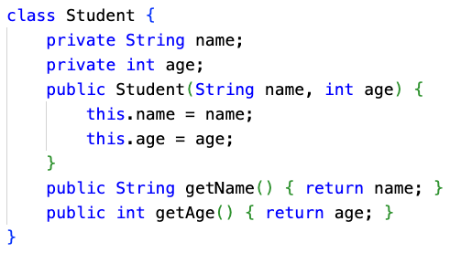
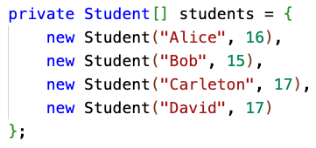
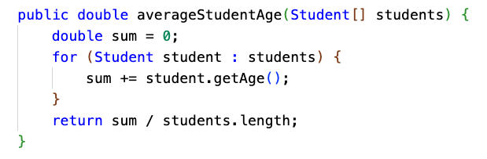
Calculations aren't always over int[] or double[]...
What if you are calculating the average age of a class of Students?

Slide 54
Median
Median is defined as the "middle element" of an array.
The array needs to be sorted for it to work.
If the array has odd length, the element in the middle is returned.
If the array is of even length, there isn't a "middle" ... so return the mathematical average of the two elements in the middle.
1 | 3 | 7 | 9 | 15 | 16 | 19
1 | 3 | 7 | 9 | 15 | 16 | 19 | 23

Slide 55
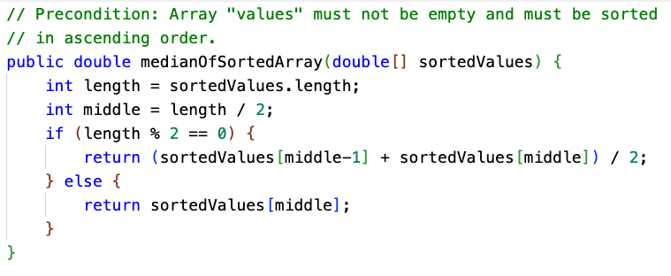
Median
The array needs to be sorted. We could declare a precondition!
We also declare a precondition that the input array must not be empty.

Slide 56
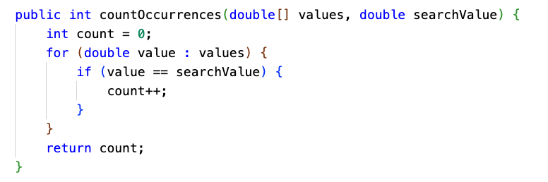
Determine number of elements meeting specific criteria

Slide 57
Mode
The mode of an array is the value that occurs most frequently.
What is the mode of this array?
17 | 17 | 9 | 9 | 9 | 9 | 1 | 17 | 19 | 3 | 3 | 5

Slide 58
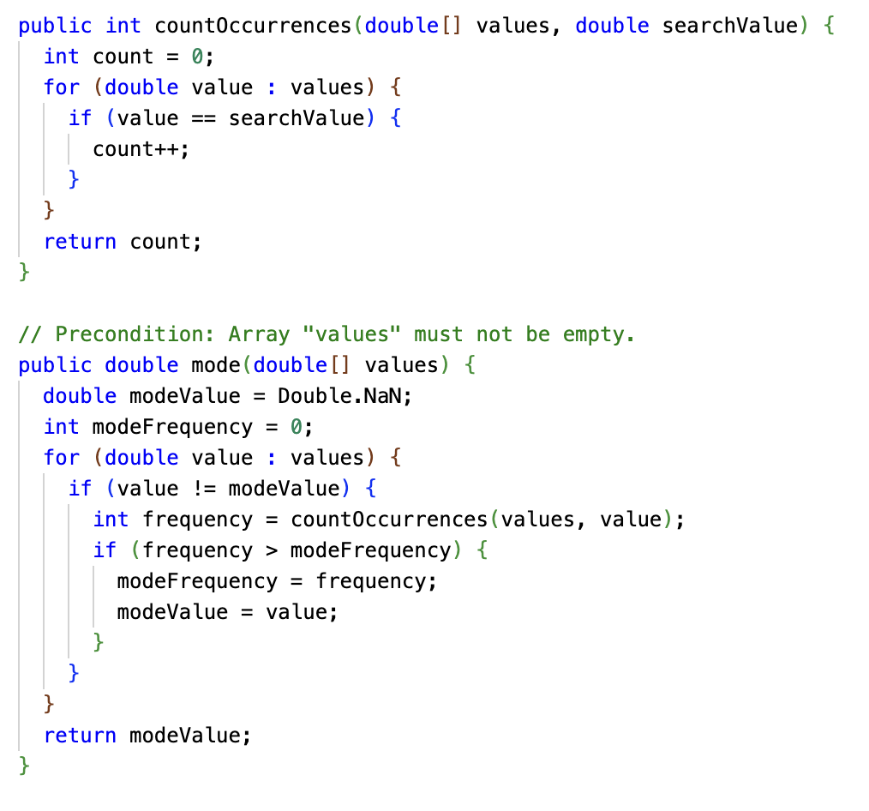
Mode
Mode could be implemented with a nested loop... an outer loop to consider each element, and and inner loop to count up occurrences of that element.
Here, we broke down the problem and used a helper method (the one from the last slide!) to count the occurrences.
Not A Number, a special double value
The running time of this algorithm is O(N²), with or without the helper method.
With a precondition that the array is sorted, the running time can be reduced to O(N).

Slide 59
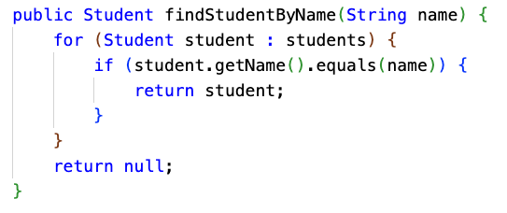
Search for a particular element in the array
Linear search or sequential search is the simplest (and least efficient) of search algorithms, with O(N) running time. If you have an unordered array, it may be the best you can do.
Binary search (to be reviewed on 4/28) is great for sorted arrays but won't work on an unordered one.

Slide 60
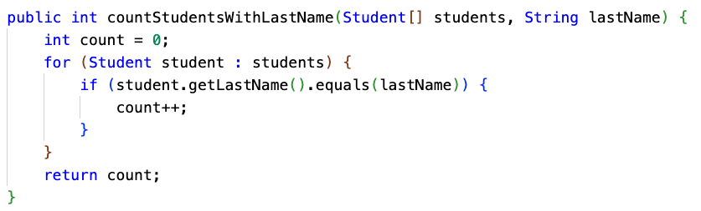
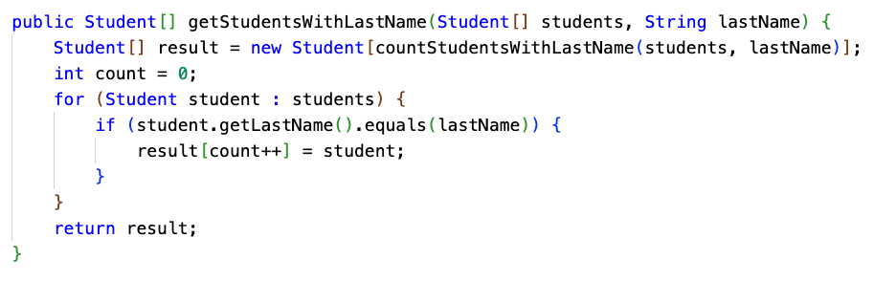
Filter an array for all matching elements
What if you want to find all matching elements? One way is to filter the array into a new array. (Maybe we'll do this today in the FRQ...)
When returning an array that is a subset of the original array, you have to decide how big to make the result array.
Here, we do it by doing another pass through the array just to count how big the result array should be, using a helper method.
Another option would be the "growable array" pattern... In Unit 7, we'll cover ArrayList which could be used for this purpose.

Slide 61
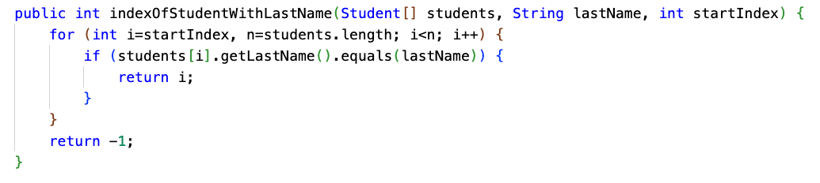
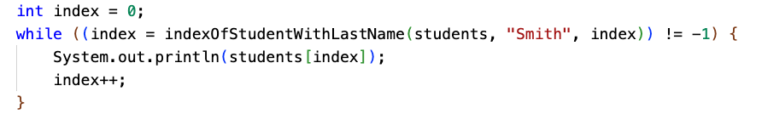
Search for all matching elements
Another way to find all matching elements is to build your own indexOf with startIndex parameter.

Slide 62
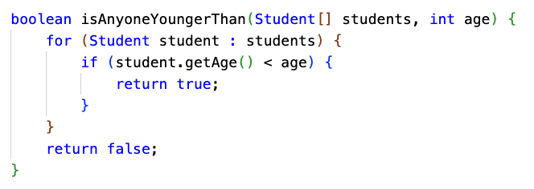
Determine if at least one element has a particular property
The output of this type of algorithm is a boolean. As soon as you find the first element with the desired property, you can return true.

Slide 63
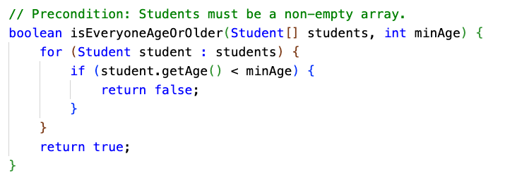
Determine if all elements have a particular property
This is essentially the same, except we're trying to ensure that ALL elements have some property. As soon as we find an element that doesn't, we return false.

Slide 64
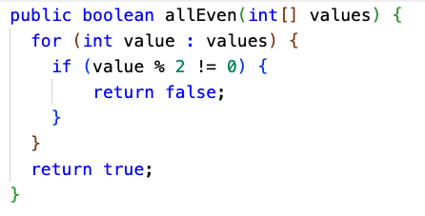
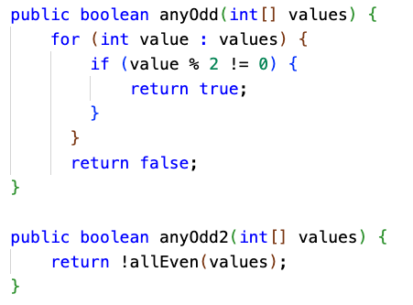
Universal / Existential Quantifiers
If all of the numbers all even, then there are no odd numbers.
If there are any odd numbers, then not all of the numbers are even.

Slide 65
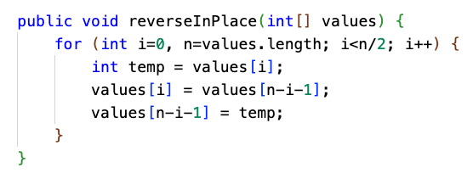
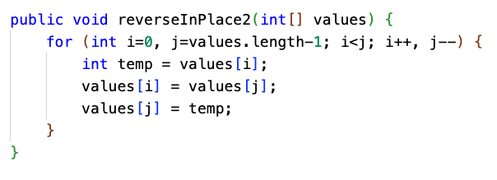
Reverse an array (in place)
The top implementation is fine, but the bottom one uses two "pointers", i and j, starting at each end of the array, instead of just i.
I find it easier to reason about what this algorithm is doing by having two index counters, "racing" toward each other from each end of the array.
Computers have many registers for storage of frequently used variables, so there is really no additional cost to having two variables instead of one. It can be even faster, since less arithmetic is performed.

Slide 66
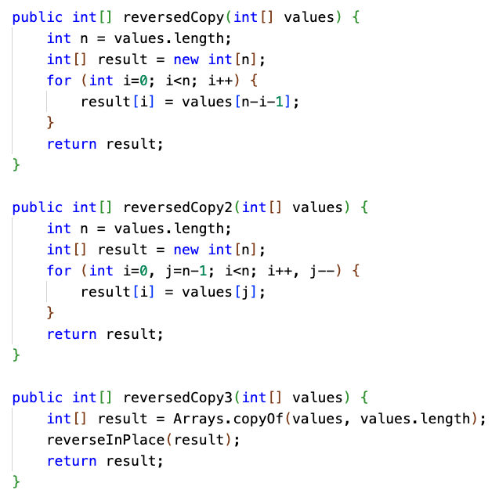
Return a reversed copy of an array
If you're returning a copy of an array in reverse order, you don't have to do any swapping.
It could still be helpful to use two counters instead of one.
You also could just not write the code at all... and leverage the reverse-in-place algorithm we just wrote. It will take a little more CPU time, though, since the array will first be copied, then reversed.

Slide 67
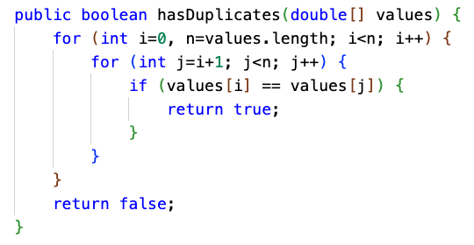
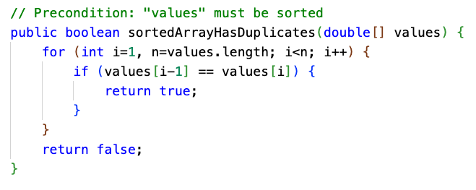
Check for presence of duplicate elements

Slide 68
Shift or rotate an array
Here, we rotate an array of numbers to the left by 1 position.
a[i] = a[i+1] for all i. The first element gets moved to the last position.
0 | 1 | 2 | 3 | 4 | 5 | 6 | 7 | 8 | 9 | 10 | 11
1 | 2 | 3 | 4 | 5 | 6 | 7 | 8 | 9 | 10 | 11 | 12
0 | 1 | 2 | 3 | 4 | 5 | 6 | 7 | 8 | 9 | 10 | 11
2 | 3 | 4 | 5 | 6 | 7 | 8 | 9 | 10 | 11 | 12 | 1

Slide 69
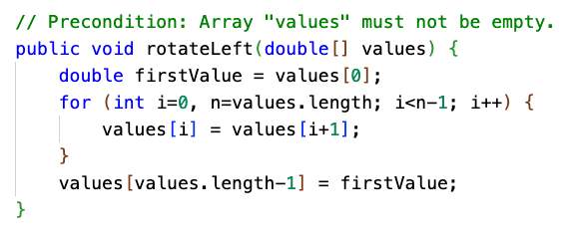
Rotate array to the left, in place
0 | 1 | 2 | 3 | 4 | 5 | 6 | 7 | 8 | 9 | 10 | 11
1 | 2 | 3 | 4 | 5 | 6 | 7 | 8 | 9 | 10 | 11 | 12
0 | 1 | 2 | 3 | 4 | 5 | 6 | 7 | 8 | 9 | 10 | 11
2 | 3 | 4 | 5 | 6 | 7 | 8 | 9 | 10 | 11 | 12 | 1

Slide 70
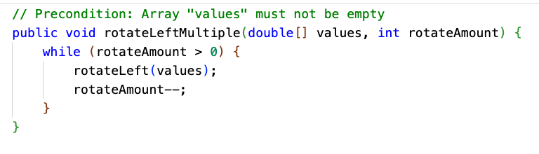
Rotate array to the left multiple positions, in place
There are other ways... but this is a quick and dirty way to do it.

Slide 71
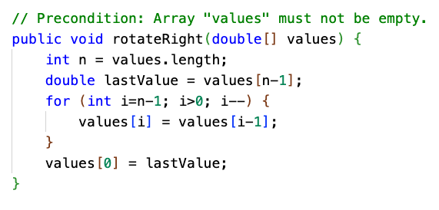
Rotate array to the right, in place
0 | 1 | 2 | 3 | 4 | 5 | 6 | 7 | 8 | 9 | 10 | 11
1 | 2 | 3 | 4 | 5 | 6 | 7 | 8 | 9 | 10 | 11 | 12
0 | 1 | 2 | 3 | 4 | 5 | 6 | 7 | 8 | 9 | 10 | 11
12 | 1 | 2 | 3 | 4 | 5 | 6 | 7 | 8 | 9 | 10 | 11

Slide 72
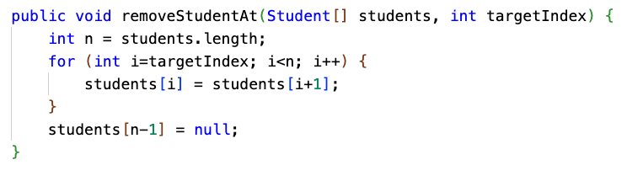
Remove element at specific index from an array
This is essentially like rotating left, but starting at a particular spot. Here, we fill in the end with null.

Slide 73
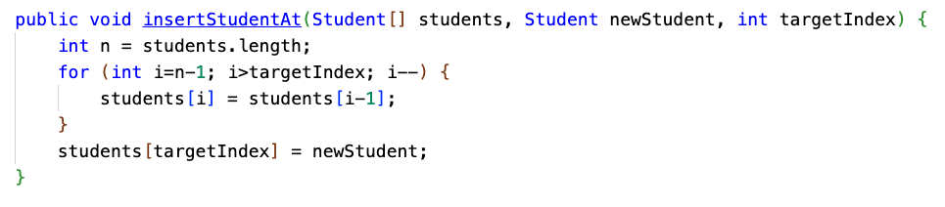
Insert element at specific index in array
This is very similar to rotating the array right, but starting at a specific index and not "wrapping."
The last element will be lost, so you'd have to make sure there is empty space at the end!

Slide 74
AP CS FRQ 3 (25 minutes)
2022 AP Computer Science A - Free-Response Questions
Complete (3.A) and (3.B)

Slide 75
AP CS FRQ 3 - Review (15 minutes)
Sample Responses and Scoring Commentary - FRQ-3

